Slide 1
Introduction to Pandas
Overview: Pandas is a powerful library for data manipulation and analysis in Python.
Key Features:
Data cleaning
Data transformation
Data analysis

Slide 2
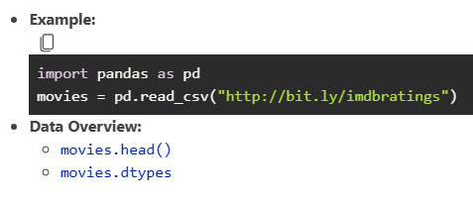
Loading Data

Slide 3
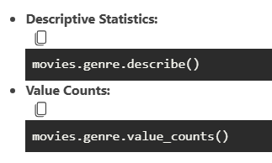
Exploring Data

Slide 4
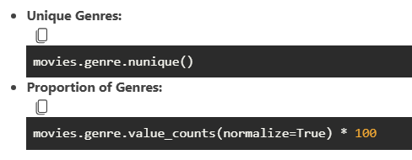
Analyzing Genre Data

Slide 5
Cross-Tabulation
pd.crosstab(movies.genre, movies.content_rating)

Slide 6
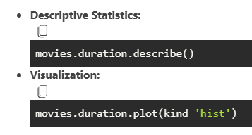
Duration Analysis

Slide 7
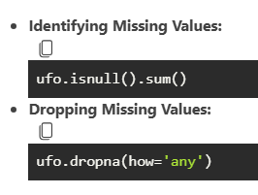
Handling Missing Values

Slide 8
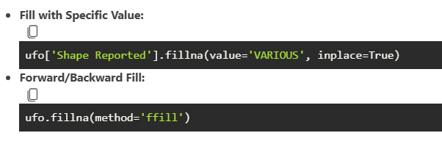
Filling Missing Values

Slide 9
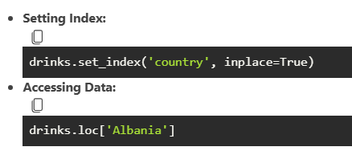
Indexing and Setting Index

Slide 10
Merging Data

